Slide 1
The Transport Functions of Cells
Dr Jigisha Patel
jigisha.a.patel@ucl.ac.uk

Slide 2
Transport Functions
This lecture will discuss:
The nature of the cell membrane.
How molecules cross the cell membrane.
  Channels, carriers and metabolic pumps
The difference between active and passive transport.
How ion gradients are established across the cell membrane.
How these gradients are exploited by cells.
The mechanisms of constitutive and regulated secretion.
Endocytosis.

Slide 3
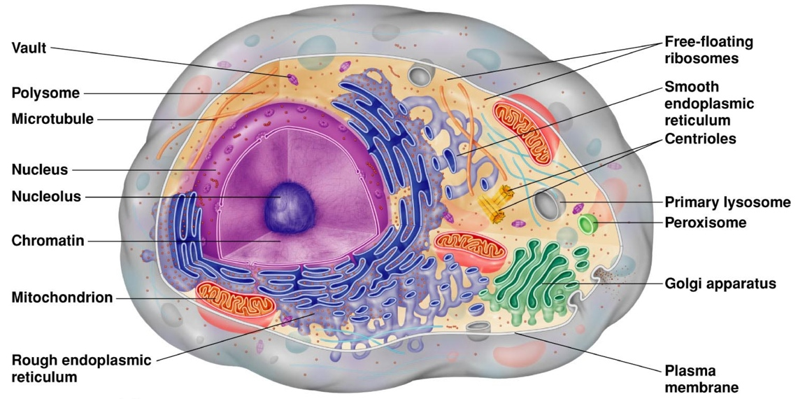
Structure of a Typical Cell
Copyright 2008 Pearson Education, Inc., publishing as Benjamin Cummings

Slide 4
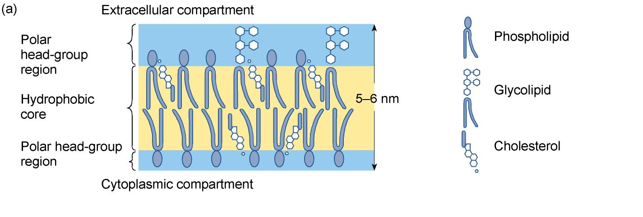
Plasma Membrane
The plasma membrane consists of a lipid bilayer made up of phospholipids, glycolipids and cholesterol.

Slide 5
The plasma membrane provides a hydrophobic barrier:
Plasma Membrane
This separates two main compartments:
  Fluid inside cell = intracellular fluid (ICF).
  Fluid outside cell = extracellular fluid (ECF).
Lipid soluble molecules cross the membrane freely because they can dissolve in the lipid bilayer.
  This is how oxygen and carbon dioxide cross the cell membrane.
The lipid bilayer is much less permeable to ions and polar molecules, including water, which cross the plasma by way of specific membrane protein assemblies.

Slide 6
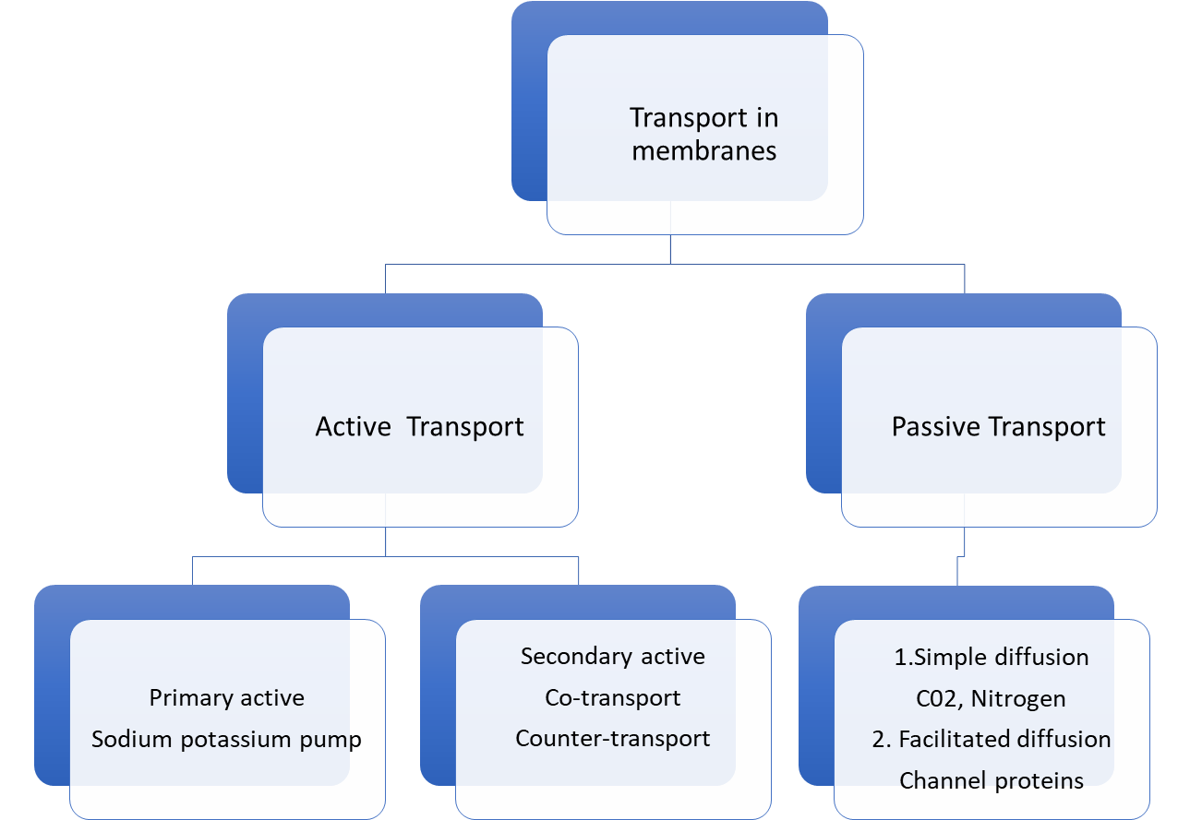
TYPES OF TRANSPORT
Two types of basic mechanisms are involved in the transport of substances across the cell membrane.
Passive transport mechanism
Active transport mechanism

Slide 7
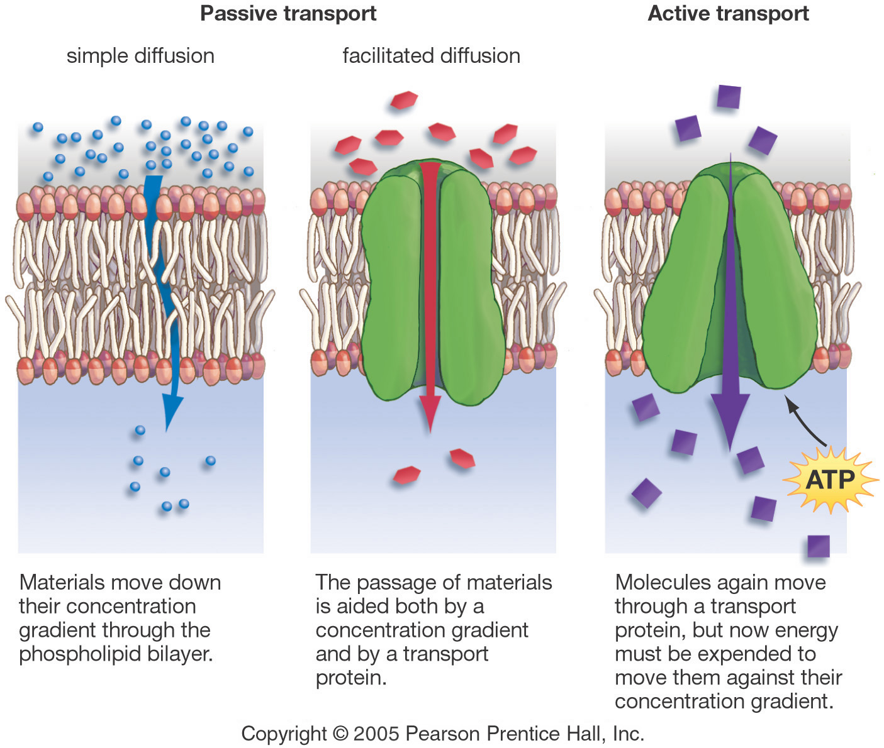
Three Forms of Transport Across the Membrane

Slide 8
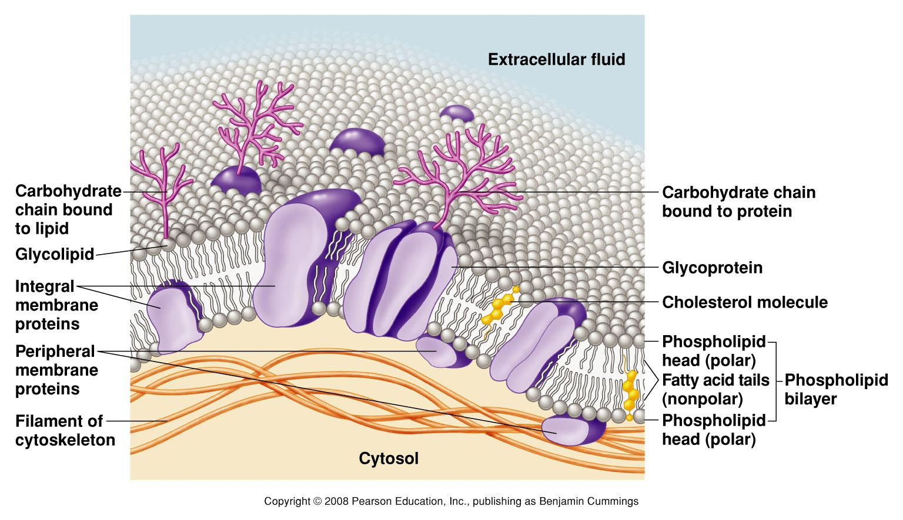
Plasma Membrane
Embedded in the bilayer are proteins ~55%
  Most of the membrane’s functions are accomplished by the embedded proteins.
    Integral proteins span the membrane
    Peripheral proteins are on one side or the other of the membrane
Copyright 2008 Pearson Education, Inc., publishing as Benjamin Cummings

Slide 9
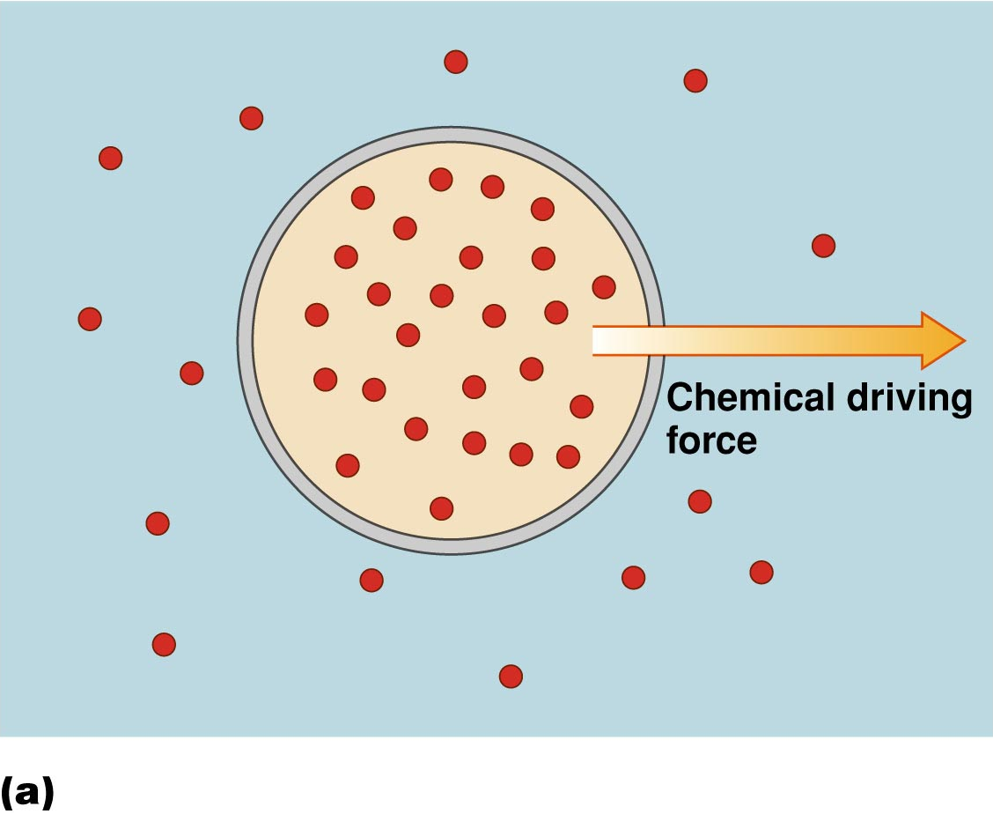
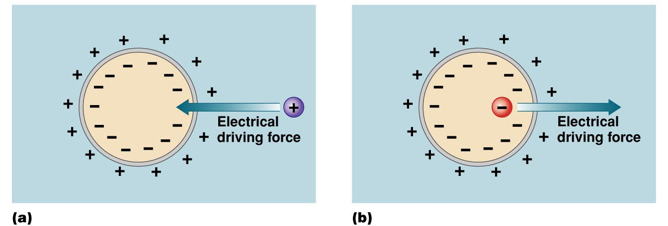
What determines the direction of transport across the cell membrane?
Membrane Transport
Cell membrane controls what gets in or out
Need to allow some materials — but not all — to pass through the membrane
  semi-permeable
    only some material can get in or out
1. The concentration gradient : drives diffusion
  2. The charge of the molecule or ion.
3. The membrane potential.
Electrochemical gradient
These three factors together determine the electrochemical gradient

Slide 10
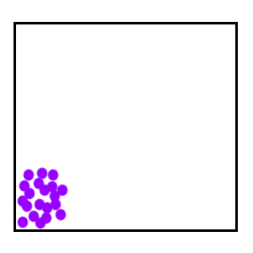
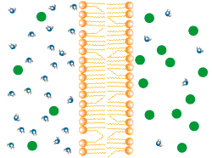
Diffusion
Move from HIGH to LOW concentration
  passive transport
  no energy needed
diffusion of water
diffusion
osmosis

Slide 11
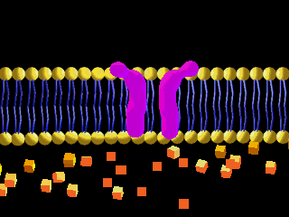
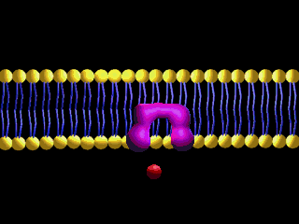
FACILITATED DIFFUSION
Facilitated diffusion is the net movement of molecules from a high concentration to a low concentration with the aid of channel or carrier proteins.
Doesn’t require energy
Some Carrier proteins do not extend through the membrane.
They bond and drag molecules through the lipid bilayer and release them on the opposite side.

Slide 12
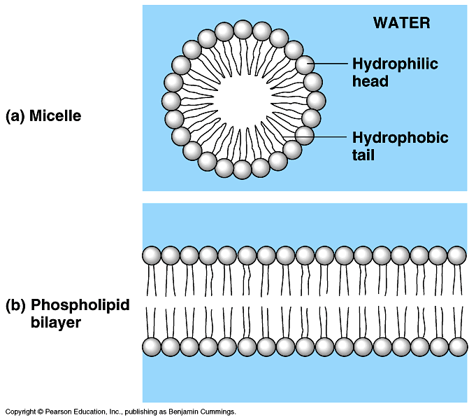
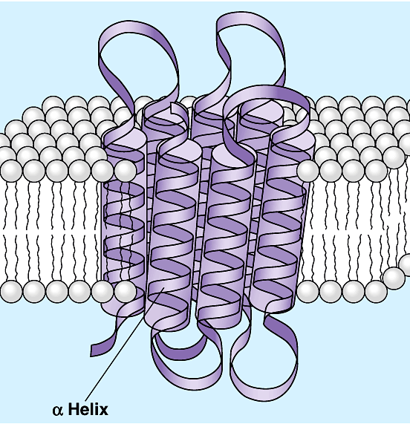
Cell membrane channels
  Water channels
  Ion channels
  Carrier proteins
  Channel proteins and carrier proteins permit polar molecules to cross the plasma membrane
salt
outside cell
waste
inside cell
H₂O
aa
sugar

Slide 13
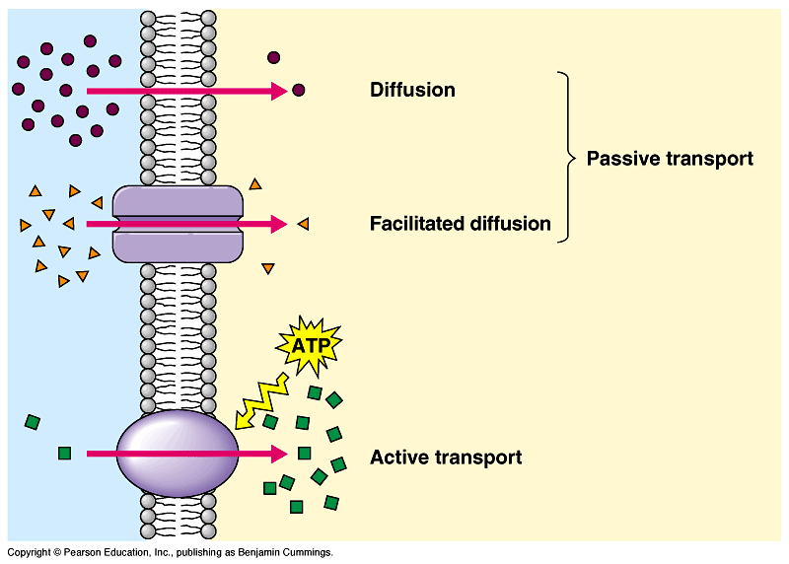
Transport summary
simple
diffusion
facilitated
diffusion
ATP
active
transport

Slide 14
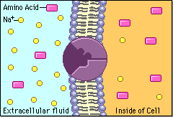
Active transport
Cells may need molecules to move against concentration “hill”
  need to pump “uphill”
    from LOW to HIGH using energy
  protein pump
  requires energy
    ATP
ATP
Notes:
Plants have nitrate & phosphate pumps in their roots.
Why?
Nitrate for amino acids
Phosphate for DNA & membranes
Not coincidentally these are the main constituents of fertilizer.

Slide 15
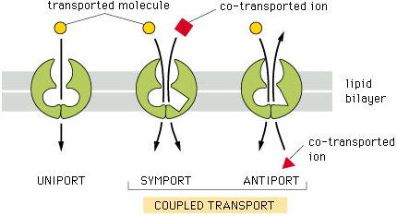
Types of Active Transport
Primary Active Transport
  The energy is directly liberated from the breakdown of ATP.
  Sodium, potassium, calcium, hydrogen and chloride are transported across the cell membrane.
2. Secondary Active Transport
  The transport of a substance with sodium ion by means of a common carrier protein.
    Co-transport
    Counter transport

Slide 16
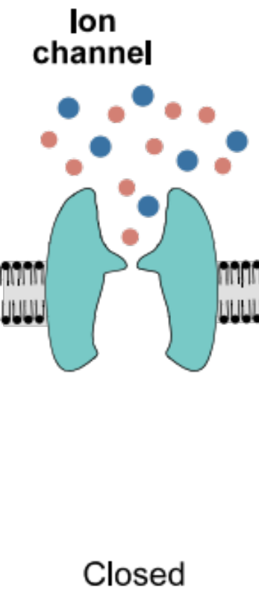
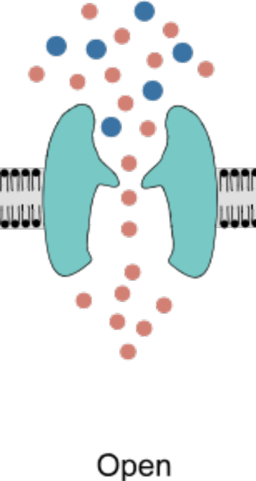
Ion Channels
Primary Active Transport
Sodium-Potassium Pump (Na⁺-K⁺ ATPase pump)
  Transports sodium from inside to outside the cell and at the same time pumps K⁺ from outside to inside the cell.
  Maintain sodium and potassium concentrations
  Establishing a negative electrical voltage inside the cells

Slide 17
Ion Channels - Properties
Have a central pore through which ions can diffuse down their electrochemical gradient.
Diffusion through pore is passive.
Are selective for particular ions.
Generally have a high capacity for transport.
Are named after the principal ion they transport.
Can be Leak channels or Gated channels.

Slide 18
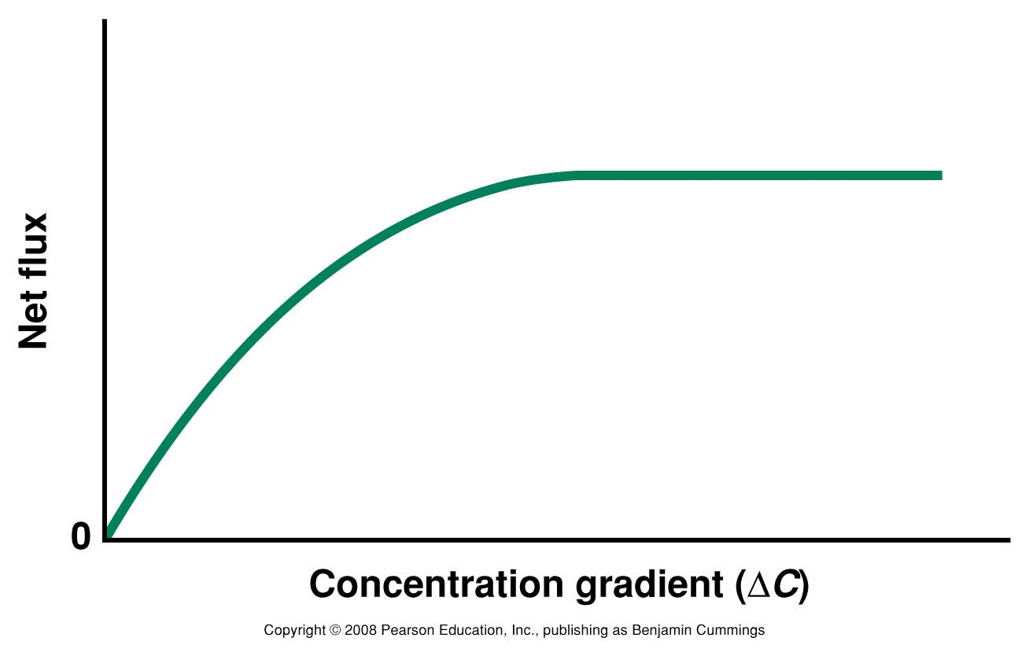
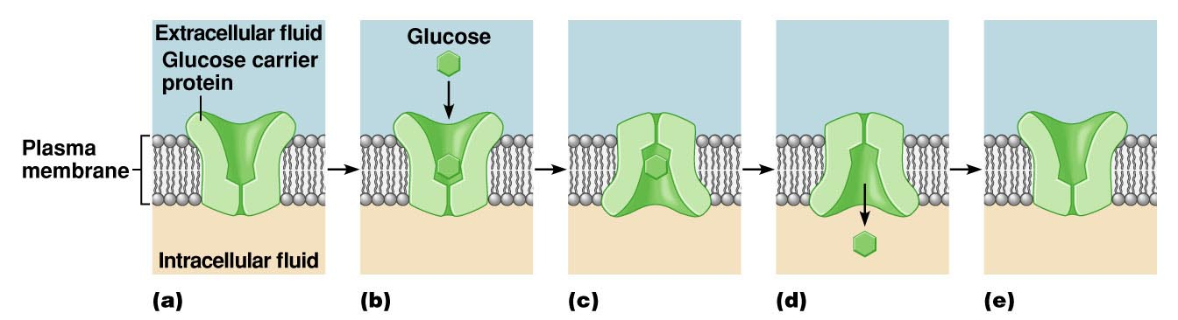
Carrier Proteins
Carrier proteins transport ions and small organic molecules across the plasma membrane by facilitated diffusion.
Transmembrane protein.
Has binding sites for specific particles.
Binding occurs one side at a time.
  Carriers demonstrate saturation:
Copyright 2008 Pearson Education, Inc., publishing as Benjamin Cummings

Slide 19
Carrier Proteins
Transport small organic molecules and ions.
Can distinguish different shapes of molecule.
  They show stereoselectivity.
May transport more than one ion or molecule at a time.
May transport substances against their electrochemical gradient.
Tend to transport fewer molecules or ions than channels in a given period of time.

Slide 20
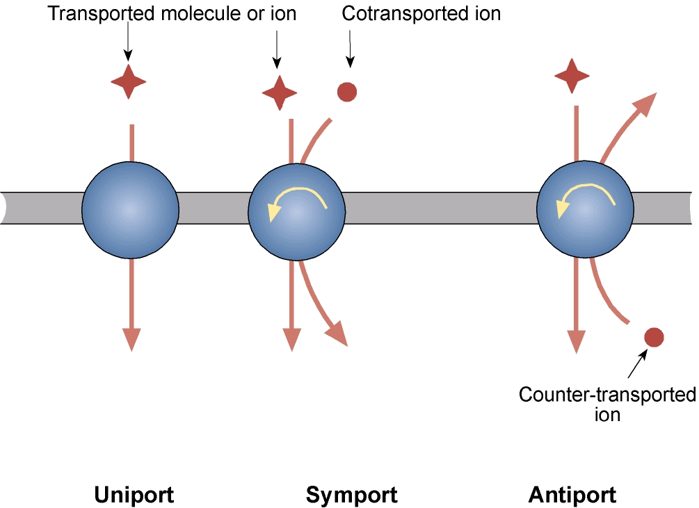
Carrier Proteins
Secondary Active Transport
Different types of carrier protein:
Couple the movement of 2 molecules in several ways:
  Symport – move both in the same direction
  Antiport – move in opposite direction
Carrier proteins that only carry one molecule is called uniport

Slide 21
Active Transport
Cells can transport some molecules and ions against their electrochemical gradients.
This is called active transport.
For some ions, active transport requires ATP.
    – This is called primary active transport.
    – It is important in establishing ion gradients.
    – The sodium pump is the classic example.

Slide 22
Sodium Pump
The sodium pump is a ubiquitous feature of mammalian cells. It uses ATP to pump Na+ out of cells in exchange for K+ .

Slide 23
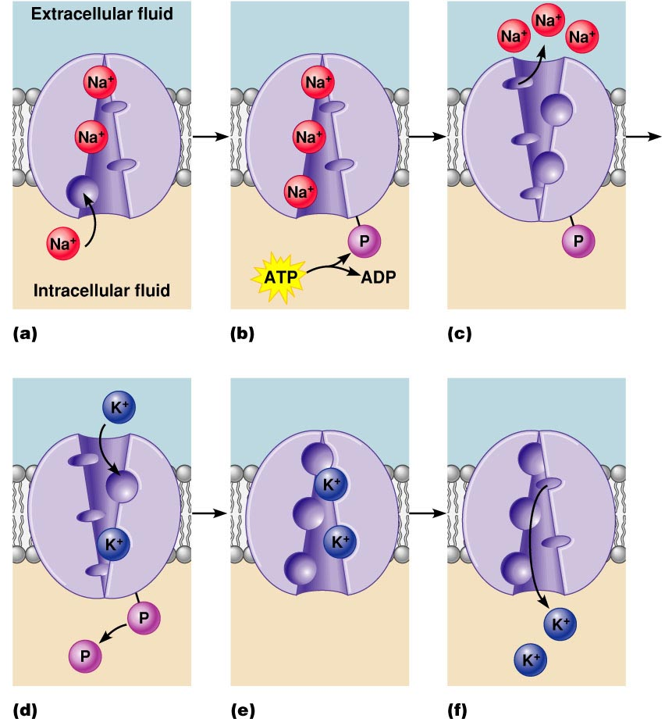
Sodium Pump
Copyright 2008 Pearson Education, Inc., publishing as Benjamin Cummings

Slide 24
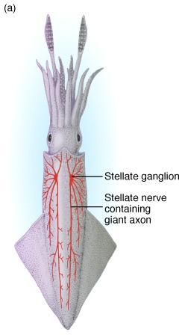
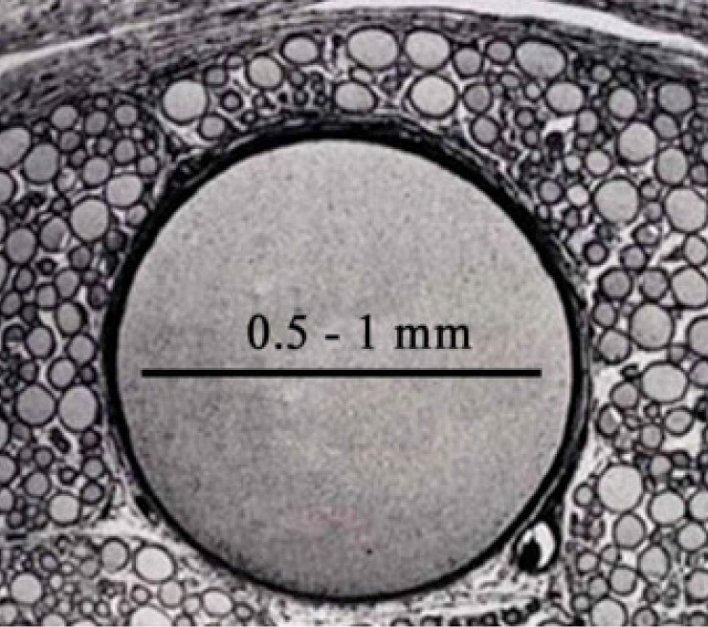
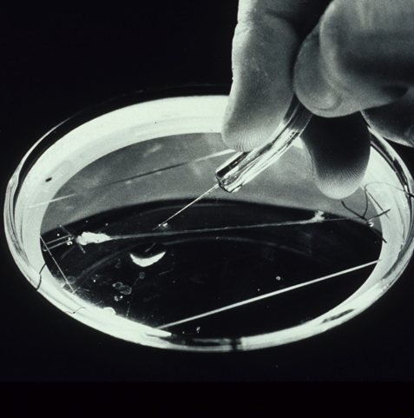
Sodium Pump
Evidence of how the Na⁺ pump works came from experiments on the giant axons of squid.
These were rediscovered by JZ Young (UCL, 1945-75) in 1936.
These huge axons trigger contractions in the squid’s mantle that propel it backwards out of danger.
-To be emailed to personal tutor by 5pm on 11th October 20
Cross-section of stellate nerve showing giant axon
NIH Library

Slide 25
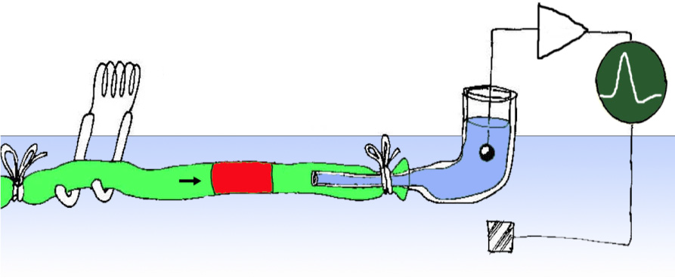
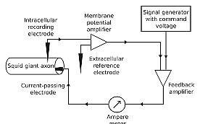
Sodium Pump
Alan Hodgkin and Andrew Huxley succeeded in making the first transmembrane DC recordings of the resting potential and the action potential by inserting glass electrodes inside the giant axon.
Two independent micro-electrodes are inserted into the squid giant axon
One for recording the voltage difference across the membrane and the other for intracellularly injecting the current.
These electrodes are then connected to a feedback circuit that compares the measured voltage across the membrane with the voltage desired by the experimenter.
If these two values differ, then current is injected into the axon to compensate for this difference.

Slide 26
Sodium Pump

Slide 27
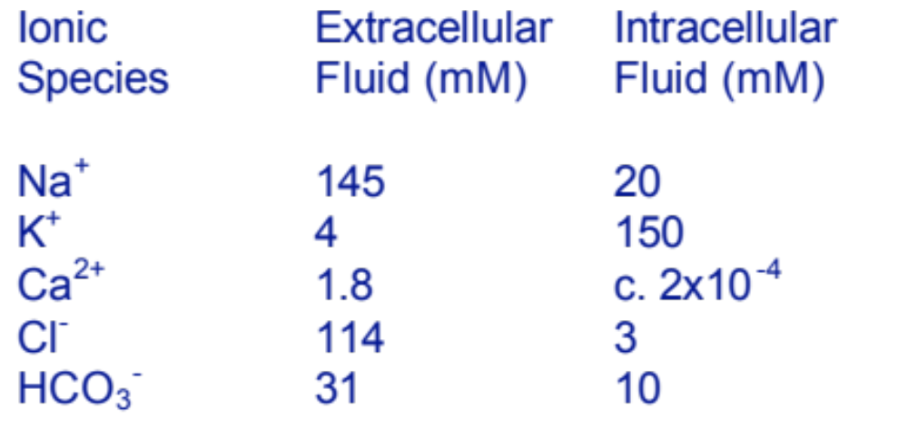
The activity of the Na⁺ pump results in the cytoplasm being rich in K⁺ but low in Na⁺:
Sodium Pump
Total 295.8 mM 183 mM

Slide 28
Secondary Transport
Cells can exploit ion gradients to transport molecules against their electrochemical gradient.
This is known as secondary active transport.
It exploits the different properties of symport and antiport carriers.
Secondary active transport is particularly important for the transport of amino acids and glucose across sheets of cells called epithelia.
The epithelia lining of the intestine and kidneys tubules are good examples.

Slide 29
Glucose Uptake
The absorption of glucose by the small intestine is an example of secondary active transport.

Slide 30
Transport Mechanisms
Summary of transport mechanisms
Type of transport | Active or Passive | Carrier-mediated | Uses metabolic energy | Dependent on Na+ gradient
Simple diffusion | Passive, downhill | No | No | No
Facilitated diffusion | Passive, downhill | Yes | No | No
Primary active transport | Active, uphill | Yes | Yes, direct | No
Co-transport | Secondary active | Yes | Yes, indirect | Yes
Counter-transport | Secondary active | Yes | Yes, indirect | Yes
CO₂/O₂/Urea
Ions/H₂0/Glucose
Sodium Pump
Glucose symport
Solutes move in the same direction
as Na+ across the cell membrane
Na⁺/Ca²⁺ exchanger
Solutes move in the opposite direction
as Na+ across the cell membrane

Slide 31







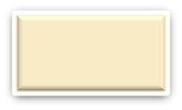

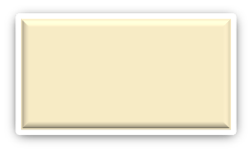
TYPES OF TRANSPORT ACROSS CELL MEMBRANES
SMALL MOLECULES
LARGE MOLECULES
PASSIVE TRANSPORT
ACTIVE TRANSPORT
ENDOCYTOSIS
EXOCYTOSIS
Simple Diffusion
Facilitated Diffusion
Gated ion channel

Slide 32
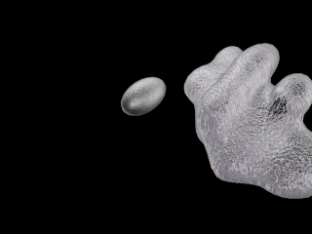

Large Molecule transport
How about large molecules?
Moving large molecules into & out of cell
  through vesicles & vacuoles
  1.endocytosis
    phagocytosis = “cellular eating”
    pinocytosis = “cellular drinking
    receptor-mediated
    endocytosis
  2.exocytosis

Slide 33
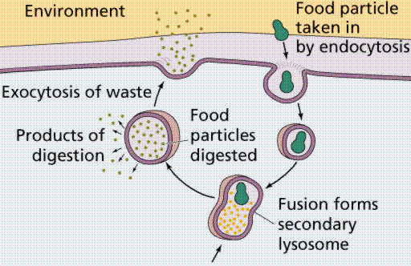
Transport Via Compartments
  Membrane bound compartments are used for the transport of macromolecules such as enzymes, receptors and hormones.
  Exocytosis = secretion of molecules
  Endocytosis = absorption of molecules
  A balance is struck between exocytosis and endocytosis which keeps the area of cell membrane roughly constant.

Slide 34
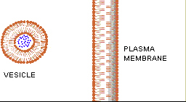
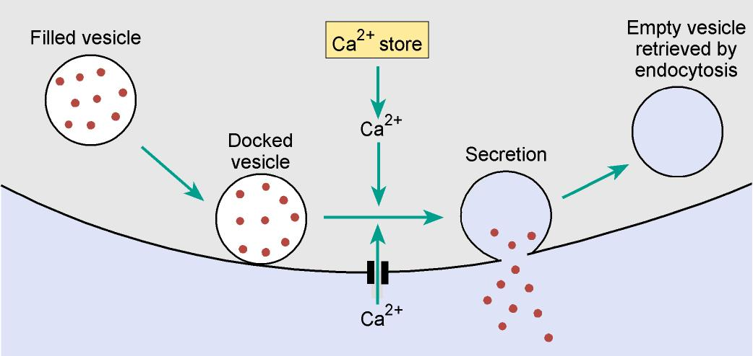
Exocytosis
Constitutive
Performed by all cells to release components of the or just deliver newly-synthesized membrane proteins.
Regulated
Triggered by a chemical or electrical signal such as rise in intracellular Ca²⁺ e.g. hormone or neurotransmitter release.

Slide 35
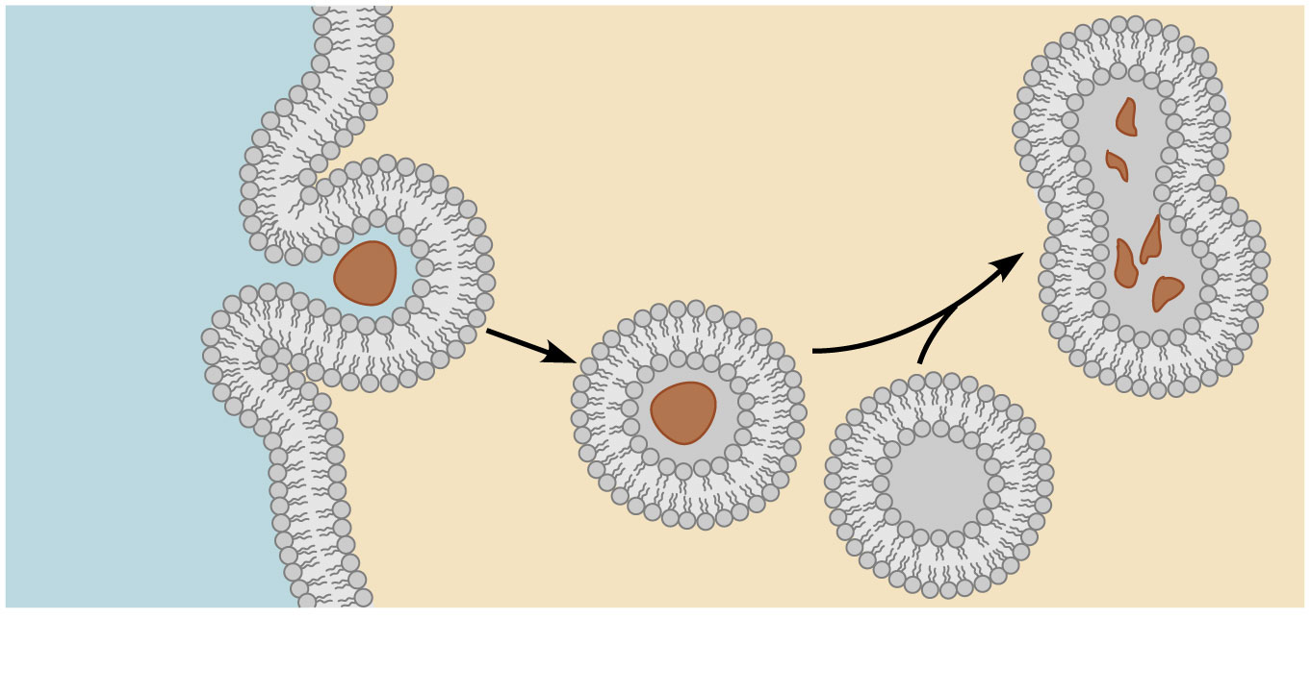
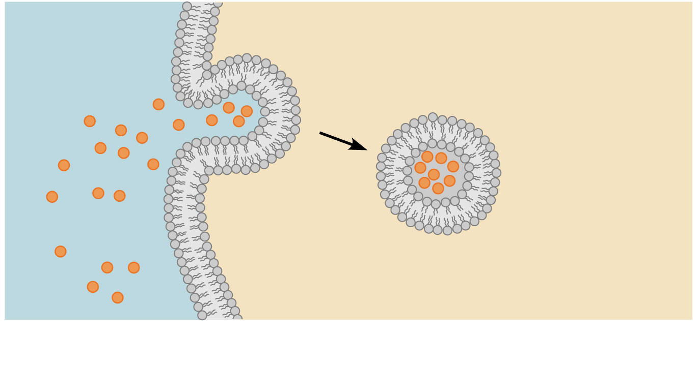
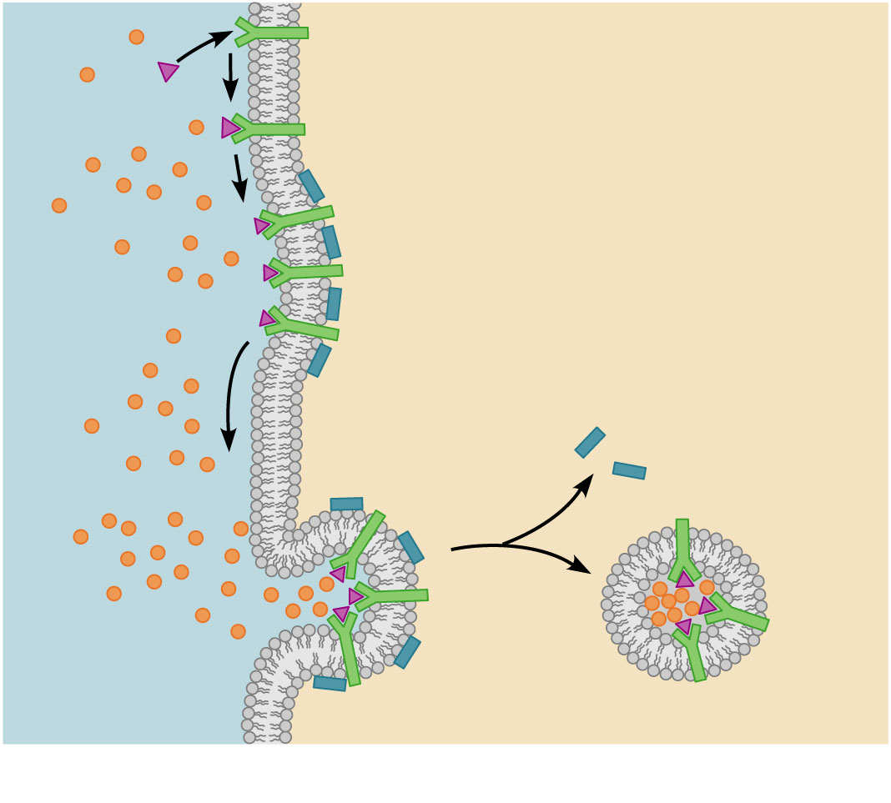
Endocytosis
Extracellular
ﬂuid
Intracellular ﬂuid
Phagocytosis (literally, cell-eating)
Absorption of solids, such as bacteria, viruses, or the remnants of cells which have undergone apoptosis.
Particle
Phagosome
Plasma
membrane
engulﬁng
particle
Lysosome
Pinocytosis (literally, cell-drinking) - how cells take in liquids
Endosome
Dissolved
molecules
Receptor protein
Receptor-mediated transport
Specific active event where the cytoplasm membrane folds inward to form coated pits.
Molecule
Coated pit
Clathrin

Slide 36
Summary 1
The plasma membrane consists of a lipid bilayer with which specific proteins are associated.
Lipid soluble molecules cross the plasma membrane easily.
Polar molecules cross only with difficulty.
To facilitate the movement of polar molecules, ions and water across the membrane, cells use carriers, ion channels, and aquaporins (water channels).
The net movement of ions via ion channels is always down an electrochemical gradient via a pore
  an example of passive transport.

Slide 37
Summary 2
Carrier molecules work by binding a molecule on one face of the membrane and undergoing a conformational change to release it on the other.
The activity of some carrier molecules is directly linked to the hydrolysis of ATP to provide the energy for the transport of a substance against its electrochemical gradient.
  The sodium pump is the classic example of primary active transport.
Certain carriers use the gradient established by the sodium pump to provide the energy to move another molecule (e.g. glucose) against its concentration gradient.
  secondary active transport
  e.g. the uptake of glucose from the small intestine

Slide 38
Summary 3
Many large molecules (such as proteins) are secreted by cells. Most secretion occurs via exocytosis which is often regulated by changes in the intracellular calcium concentration.
After exocytosis, cells capture the excess membrane by endocytosis.

Slide 39
Reading
Human Physiology – The Basis of Medicine
Gillian Pocock, Christopher Richards and David Richards
4th edition, pages 65-72
3rd edition, pages 33-39
2nd edition, pages 39-46

